Slide 1





Model Transformation and Web Interface for Verifying Business Processes
Ajay MUROOR NADUMANE
Gwen SALAÜN
Student, MOSIG M1
Professor (PhD, HDR)
Université Grenoble Alpes - Grenoble INP
Université Grenoble Alpes - Inria
Notes:
The project was undertaken at Convecs team, Inria under the supervision of Prof. Gwen Salaun. More details about the team can be found here - http://convecs.inria.fr/. Prof. Salaun’s webpage is: http://convecs.inria.fr/people/Gwen.Salaun/. Ajay can be reached via his email: muroorna@e.ujf-grenoble.fr

Slide 2

A business process consists of set of tasks and activities, which may involve various participants, to accomplish a specific organizational goal [App, 2016].
1|25
Notes:
Definition of Business process: A business process consists of set of tasks and activities, which may involve various participants, to accomplish a specific organizational goal.

Slide 3
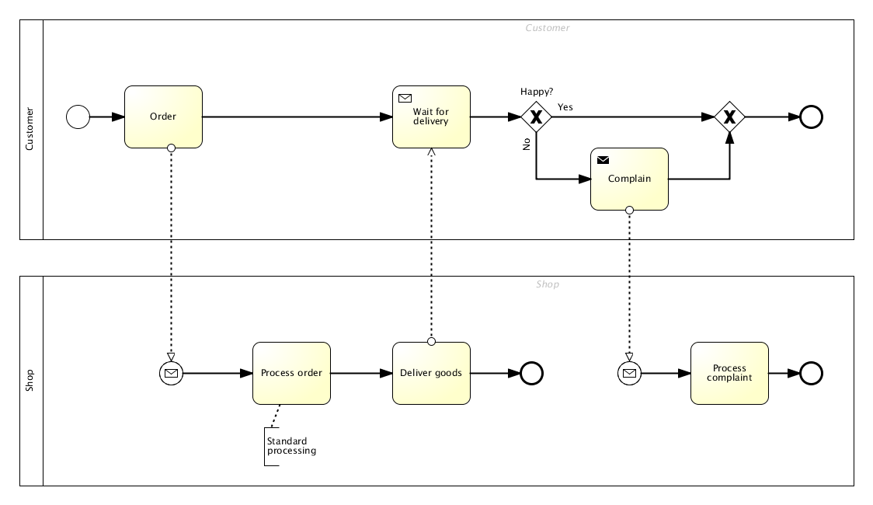

Business Process Model Notation (BPMN)
OMG STANDARD
2|25
Notes:
Business process can be represented using BPMN. It allows to represent the elements of business processes such as activities, interaction using a standardized notation. The standard allows to share and exchange process within and outside of organizations. BPMN 2.0 is the OMG standard that is currently in use.
The diagram represents a typical online delivery process. Suppose, we order something from Amazon as a customer, we place the order (the rectangular box represents an activity, the arrows represent the sequence flows), the order will be received by the vendor. The circles in the beginning and end represent start and end events. The rhombus shape represents gateways. Gateways can take concurrent or exclusive paths. The gateway is described more in detail in the paper.

Slide 4

CONTEXT
Businesses constantly evolve, so do their processes.
How can we measure the quality of evolution?
3|25
Notes:
Business model the processes based on existing processes, using modelling tools. There are lots of graphical tools available in the market. Process designers modify and optimize the processes. The redesign/upgrade can be termed as “evolution”. So when the process is evolved, how can we measure the correctness of evolution? How can we assert that the new process is better than the existing one? Do the existing tools support such validations?

Slide 5

Where existing tools fail?
Notes:
The area where existing tools fail is in measuring the quality of evolution.

Slide 6
WHERE EXISTING TOOLS FAIL?
Support only basic validation of semantics
No exhaustive verification
Infinite domains for data
Hard to identify cycles and deadlocks
4|25
Notes:
Existing tools support validation of syntax and check basic semantics. Exhaustive verification is not supported these tools.
Infinite domains for data –
Process allow loops and concurrent executions. Existing tools fail in identifying cycles and deadlocks

Slide 7

BUSINESS MOTIVATION
“Organizations have a greater focus on business transformation and addressing the dimensions of big change ….. need to reinvent themselves while also driving improvements in efficiency” – Gartner, 2015
~ USD2.7billion invested in 2015
5|25
Notes:
On a lighter note, what is the motivation for businesses to adopt such verifications or validations? There is great focus on transformation of business processes these days. Processes are getting automated and more efficient ways of operating businesses is being discovered. Validating such evolutions allows businesses to reap greater benefits from transformation.

Slide 8

Verification of BPMN (VBPMN)
VBPMN aims at formal modelling and automated analysis of business processes using formal verification tools
6|25
Notes:
VBPMN framework is being developed to bridge the gap between business processes and formal verification tools.

Slide 9
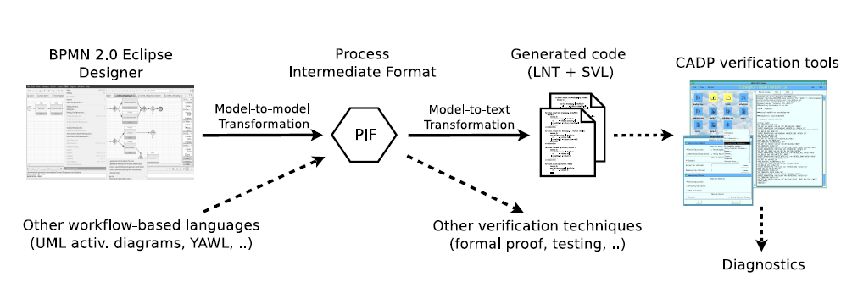
VBPMN OVERVIEW
7|30
Notes:
VBPMN framework consists of various components. In the initial step, the BPMN models undergo, model-to-model transformation to an intermediate format called PIF using a transformation engine. The intermediate format known as PIF is detailed in the later sections. Then the PIF undergoes model-to-text transformation into a formal model that could support verifications. The generated code from model-to-text transformation contains LNT and SVL files. These files are fed as input to CADP for verification.
The approach from user perspective is that they use a pair of BPMN models (original and evolved), compare them for correctness using the background verification tools. In case of a mismatch, a counter example will be displayed to the user.

Slide 10
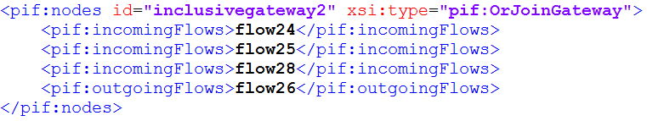
Process Intermediate Format
VBPMN OVERVIEW
XML Scheme
Supports multiple workflow languages
Link between modelers and formal verification tools
8|25
Notes:
PIF supports following elements in BPMN – StartEvent, EndEvent, SequenceFlow, Task and Gateways.

Slide 11
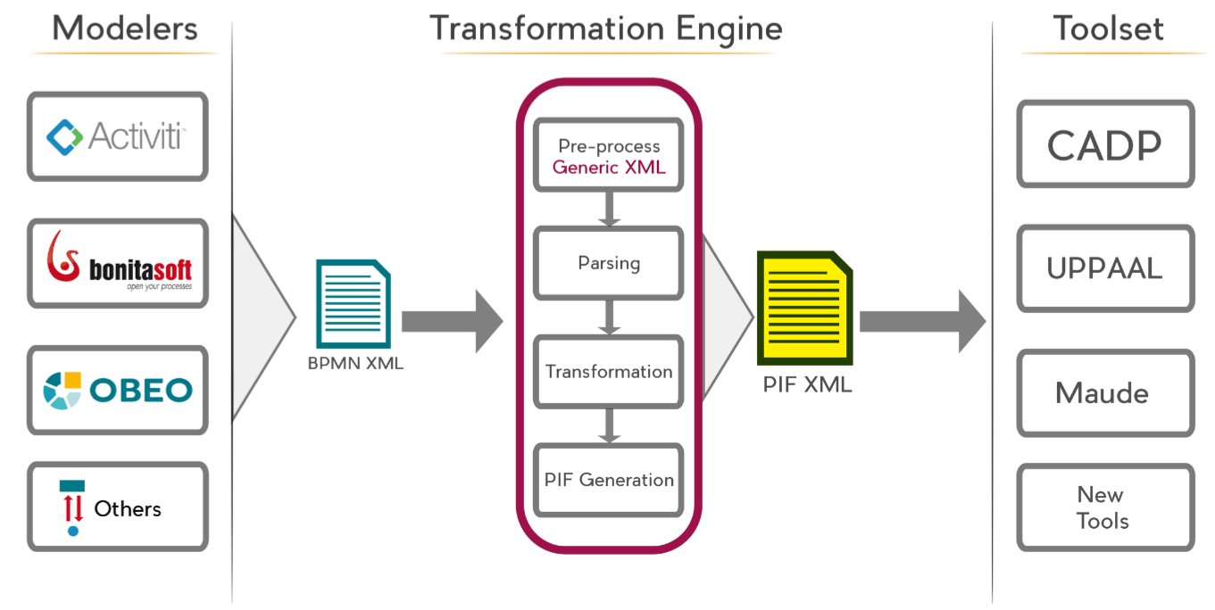
Where my contribution fits in?
Python Scripts
USER INTERFACE
9|25
Notes:
During this internship, the work was done in the front-end. To build a model-to-model transformation engine and to build an interface that supports analysis and verification features of the framework.

Slide 12
Internship Goals
Study of existing modelers
Develop an automated transformation from modeler format to PIF
Integrate transformation and analysis to a GUI
Validate the approach through real world examples
10|25
Notes:
The formal goals of the internship were
Study of existing modelers
Develop an automated transformation from modeler format to PIF
Integrate transformation and analysis to a GUI
Validate the approach through real world examples

Slide 13

Study of Popular Tools
INTERNSHIP GOALS
Activiti
Bonita BPM
Obeo Designer
jBPM
11|25
Notes:
After doing an inventory of available tools in the market, we narrowed down to freely available open source modelers. We used these tools and designed process models and analyzed their internal representation models.

Slide 14
BPMN 2.0 Compliant!
12|25
Notes:
The common theme among these designers were that they were BPMN 2.0 compliant and the models were compatible with each other. Due to the nature of BPMN spec, a slight variation is representation could be seen.

Slide 15
Transformation Strategy
Streaming parser
Pull parser
Intermediate object representation
Sequential transformation
Streaming writer
13|25
Notes:
As part of the transformation engine, an XML-to-XML transformation algorithm had to be developed. When it comes to XML, there are three dominant models for XML handling – DOM, Xpath and XML streaming. DOM is the easiest of all strategies however it is memory intensive and DOM throughput decreases considerably as the size of the input increases. DOM-parser throughput is halved when the input file's size is increased from 1-15 KB to 1-15 MB, or about 1000x larger [IEEE Computer Magazine, vol 41 nr 9, sept 2008]. Generally it is thought that DOM can occupy about 4 times the size of source document. So if we have a 256 MB JVM and ~128 MB is available for the application code. In this case, it can only parse maximum of 32 MB input at a given instance, which is quite low considering that the framework is hosted a services for users. Xpath is efficient if the exact structure of XML is known. However, the flexibility of BPMN and diversity tools make it harder to predict the XML structure. Streaming option is ideal as it not memory intensive. We have used pull parsing technique instead of push parsing as it gives more control to extract the desired elements from the model especially from the nested structures.
The transformation is sequential, each element of interest is parsed and mapped to an intermediate java object. Later PIF is generated from the intermediate java object using streaming XML writers. The intermediate object representation is designed with an eye on future – if we are to support other workflows such as YAWL, we would only have to transform them to intermediate object representation and existing logic can be reused for PIF generation from the intermediate object.

Slide 16
TRANSFORMATION FLOW
BPMN 2.0 XML Preprocessing
Element Parsing
Java Object Representation
PIF Transformation
PIF XML Generation
14|25
Notes:
The diagram captures the flow of the transformation algorithm. Since modelers’s internal XML vary a bit, a generic preprocessing is required of the input model is required for efficient parsing.

Slide 17

User Interface
Notes:
User interface was designed keeping in mind the business process users. The objective was it would be easy enough to use yet support all the features of verification. The framework is aimed at larger audience and a steep learning curve would put off the audience and slow down the adoption.

Slide 18
Comparison Modes
USER INTERFACE
Conservative
Inclusive
Exclusive
Selective
Model and Equivalence checking using CADP Tools
15|25
Notes:
Conservative comparison is the strictest of all available comparisons and it matches all the observable behaviors using the notion of strong equivalence [Milner, 1989]. Inclusive comparison is more flexible, which in turn it allows extension of process models. It allows the extended model to match as long as existing behavior is unchanged. Exclusive comparison supports refactoring involving reduction. Suppose, a process needs to be refined so that it involves only a part of existing activities, exclusive comparison ensures that the new behavior is
identical as if it has been extracted from old process. The inclusive and exclusive comparisons are complementary modes in checking evolution. The aforementioned comparisons take the whole process into account, but selective comparison is also supported. Selective comparison allows to match only the behaviors of tasks under consideration. It is done by hiding the tasks that are not under consideration in the backend. Renaming is another aspect supported by the framework. As the process evolves, it is possible that the elements get renamed. Backend uses relabeling relation [Poizat and Sala¨un,
2016] to perform equivalence checking on evolutions with renaming. Another feature supported is property-aware comparison where evolution is checked specified using temporal logic.

Slide 19

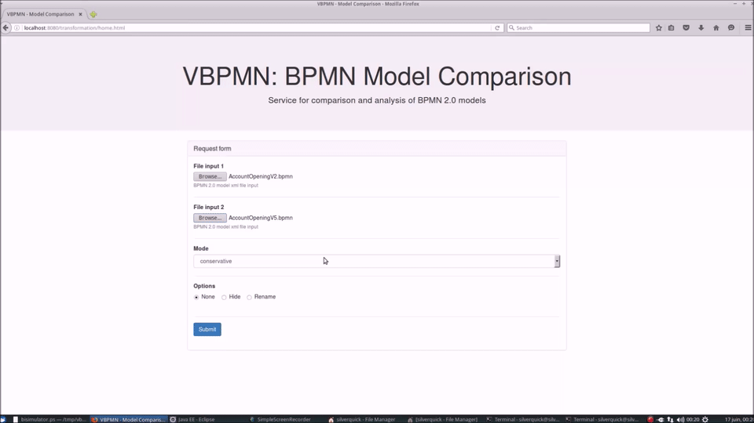





Technology Stack
HTML5/JavaScript UI
Jersey REST API
Java based transformation
Hosted on Tomcat server
Python scripts
CADP Backend
16|25
Notes:
The slide explains the technology stack used in the framework.

Slide 20

Validation
Notes:
Once the components were integrated, they were validated using through real-world processes.

Slide 21

Functional
VALIDATION
Non Functional
Java Profiling using SLF4J
Unit tests
0.696seconds
15.08seconds
Manual verification
Transformation time
Verification time
Integration tests
Process with 16 tasks, 9 gateways and 32 flows
20+
Tests
19
Models
7
Evolutions
17|25
Notes:
As the framework is business and user focused, we had to validate the non functional aspects too. On the functional side, initially the model-to-model transformation was verified manually and later on unit test created to automate such validations. We used existing real life process models, created a lot process models of varying complexities resembling the real-world to validate the approach. Once the UI was available, and the components were integrated, we ran integration tests to check end-to-end functioning of the approach.

Slide 22

Challenges
Notes:
What were the challenges encountered during this project?

Slide 23
CHALLENGES
Informal and expressive nature of BPMN specification
18|25
Notes:
Understanding the semantics of BPMN elements was quite a challenge as there are vast number of elements and some of them exhibit very flexible behaviour.

Slide 24
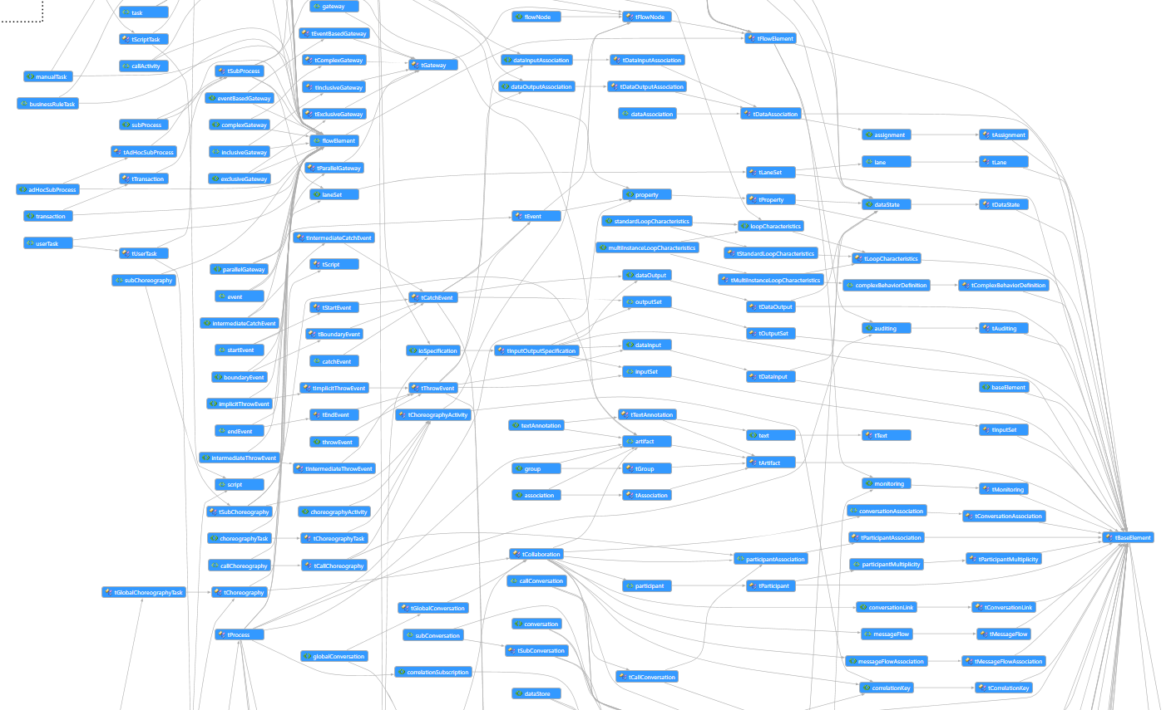
CHALLENGES
538
Page specification
19|25
Notes:
For a perspective, the figure represents the semantics of BPMN scheme and it is not exhaustive. The BPMN 2.0 spec runs up to 538 pages.

Slide 25
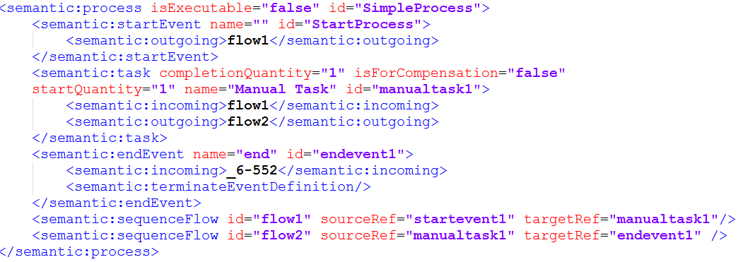
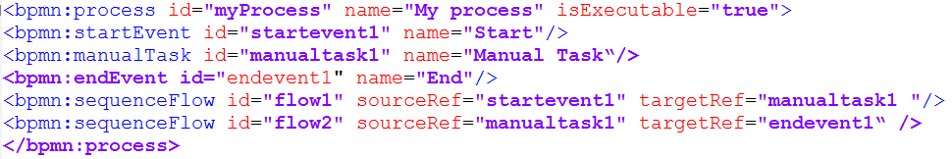
CHALLENGES
BPMN 2.0 XMLs of Different Modelers
Trisotech BPM
Bonita
20|25
Notes:
Talking about flexibility of the schema, the three process models represent internal representation of the same model using different modelers. As you can see that they operate of different namespaces and particularly, if you look at the third column from left, it represents sequence flows within the task unlike other models.

Slide 26
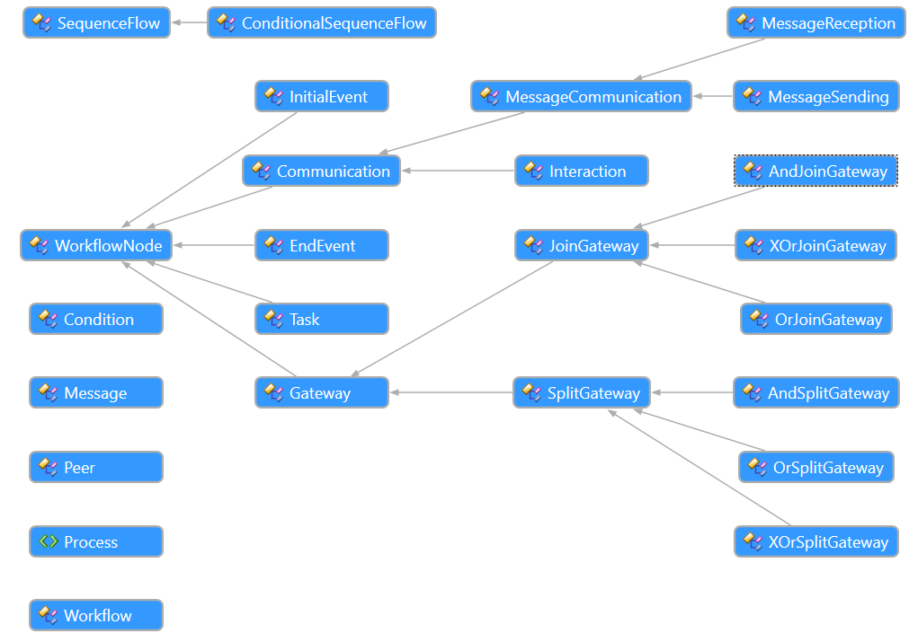
PIF Constraints
CHALLENGES
21|25
Notes:
PIF in its current state is very limited, it cannot represent all the elements of and the diagram shows all the elements available in PIF. So we need to establish rules to identify logical equivalents of BPMN elements in PIF during transformation.

Slide 27
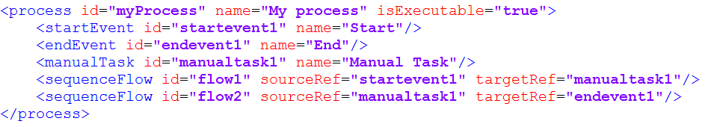
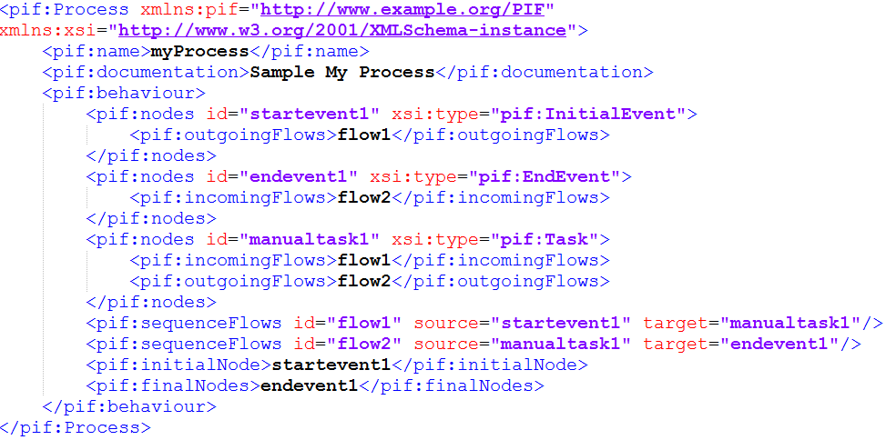
CHALLENGES
BPMN 2.0
PIF
22|25
Notes:
However, BPMN to PIF is not exactly a reduction. If you look at the figures, we can see that the PIF is considerably bigger and expressive than BPMN process model.

Slide 28






30+ Modelling tools
CHALLENGES
Integration Challenges
Components built on different platforms
OS Compatibility issues
23|25
Notes:
The sheer number of modelling tools available in the market made it difficult to identify the common internal representation among modelers. Once we narrowed down to BPMN 2.0 compliant modelers the task became simpler.

Slide 29

Road Ahead
Make PIF extensible
Counterexample to BPMN reverse transformation
Host comparison service on cloud for wider adoption
24|25
Notes:
As of now, PIF is very restrictive, we need to extend PIF and develop an extension/inheritance model where adding new features/elements would not impact existing process. XSD natively does not support inheritance.
As of now, the counterexamples are generated through Bisimulator[Mateescu and Oudot,
2008]. These counter examples and later converted into postscript files for viewing. The future work will include converting the BCG models back into BPMN, so that users can view them within the modelling tool.
Hosting VBPMN as a service for wider adoption is planned as part of the future work.

Slide 30
Recap Goals
Study of existing modelers
Develop an automated transformation from modeler format to PIF
Integrate transformation and analysis to a GUI
Validate the approach through real world examples
25|25

Slide 31
Thank you!

Slide 32
References
[App, 2016] Appian Business Process Definition.
http://www.appian.com/about-bpm/definition-of-a-business-process/, 2016.Accessed: 2016-06-03.
[Champelovier et al., 2015] David Champelovier, Xavier Clerc, Hubert Garavel, Yves Guerte, Frdric Lang, Christine
McKinty, Vincent Powazny, Wendelin Serwe, and Gideon Smeding. Reference manual of the lnt to lotos translator. 2015.
[Gar, 2016] Gartner IT Glossary BPM. http://www.gartner.com/it-glossary/business-process-management-bpm/, 2016.
[OMG, 2011] OMG. Business Process Model and Notation (BPMN), Version 2.0, January 2011.
[Poizat and Salaun, 2012] Pascal Poizat and Gwen Salaun. Checking the realizability of BPMN 2.0 choreographies.
[Poizat and Sala¨un, 2016] Pascal Poizat and Gwen Salaun. Checking business process evolution. Manuscript in preparation, July 2016.
[Salaun, 2015] Gwen Salaun. Formal modelling and analysis of bpmn processes. In LCC Seminar, Malaga, Spain, October 2015.
[Sun-Microsystems, 2005] Sun-Microsystems. Streaming APIs for XML Parsers. http://www.oracle.com/technetwork/articles/java/stax-1-0-150030.pdf, 2005. Accessed: 2016-05-23.

